Slide 1

UNIVERSITY OF MASSACHUSETTS
Dept. of Electrical & Computer Engineering
Digital Computer Arithmetic
ECE 666
Part 3
Sequential Algorithms for Multiplication and Division
Israel Koren
Spring 2004

Slide 2
Sequential Multiplication
X, A - multiplier and multiplicand
X=xn-1xn-2...x0 ; A=an-1an-2...a1a0
xn-1,an-1 - sign digits (sign-magnitude or complement methods)
Sequential algorithm - n-1 steps
Step j - multiplier bit xj examined; product xjA added to P - previously accumulated partial product (P =0)
Multiplying by 2 - shift by one position to the right - alignment necessary since the weight of xj+1 is double that of xj
(j)
(0)
-1

Slide 3
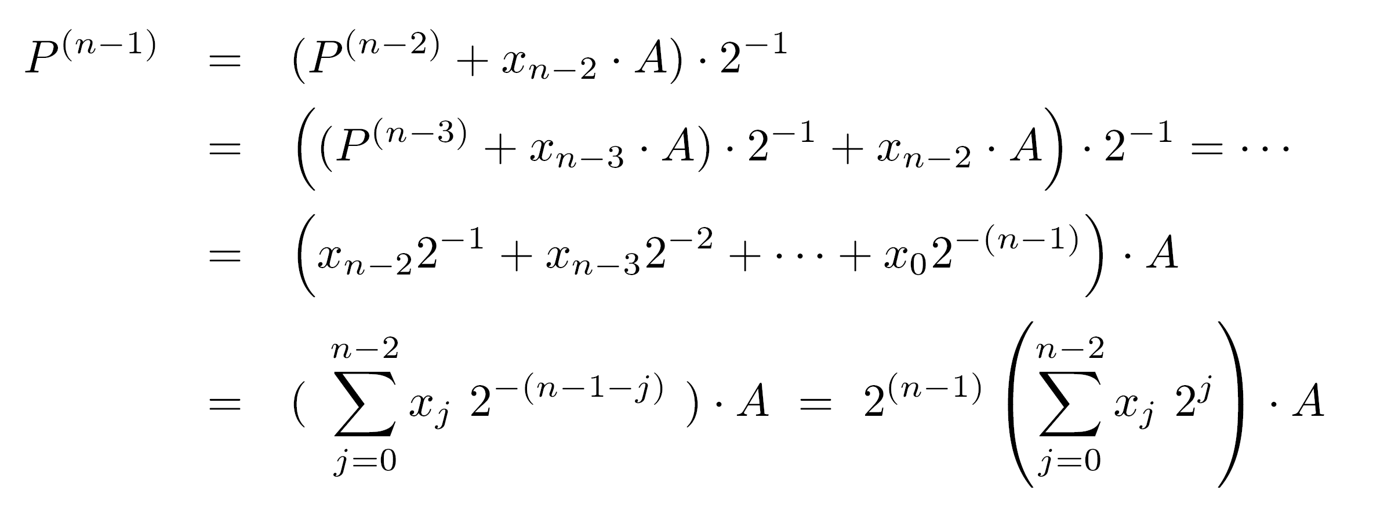
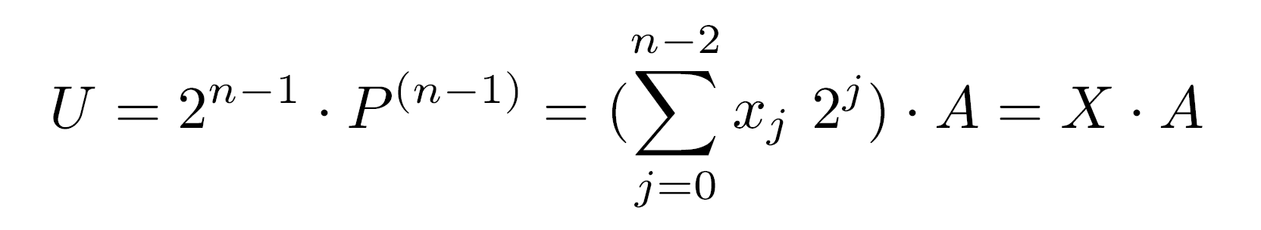
Sequential Multiplication - Proof
Repeated substitution
If both operands positive (xn-1=an-1=0) -
The result is a product consisting of 2(n-1) bits for its magnitude
=2
-(n-1)

Slide 4
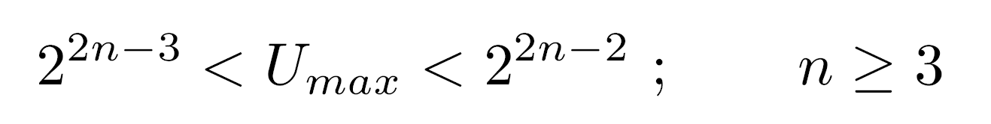
Number of product bits
Maximum value of U - when A and X are maximal
Last term positive for n≥3, therefore
2n-2 bits required to represent the value - 2n-1 bits with the sign bit
Signed-magnitude numbers - multiply two magnitudes and generate the sign separately (positive if both operands have the same sign and negative otherwise)

Slide 5
Negative operands
For two's and one's complement - distinguish between multiplication with a negative multiplicand A and multiplication with a negative multiplier X
If only multiplicand is negative - no need to change the previous algorithm - only add some multiple of a negative number that is represented in either two's or one's complement

Slide 6
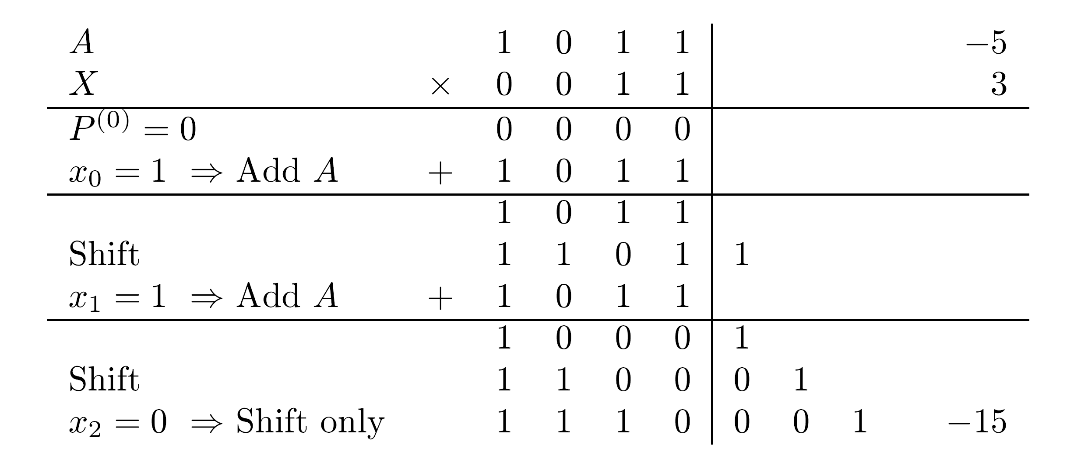
Multiplication - Example
A - negative, two's complement, X - positive, 4 bits
Product - 7 bits, including sign bit
Registers are 4 bits long - a double-length register required for storing the final product
Vertical line separates most from least significant half - each stored in a single-length register
  Bits in least significant half not used in the add operation

Slide 7
Least significant half of product
Only 3 bit positions are utilized - least significant bit position unused - not necessarily final arrangement
The 3 bits can be stored in 3 rightmost positions
Sign bit of second register can be set in two ways
  (1) Always set sign bit to 0, irrespective of sign of the product, since it is the least significant part of result
  (2) Set sign bit equal to sign bit of first register
Another possible arrangement -
  Use all four bit positions in second register for the four least significant bits of the product
  Use the rightmost two bit positions in the first register
  Insert two copies of sign bit into remaining bit positions

Slide 8
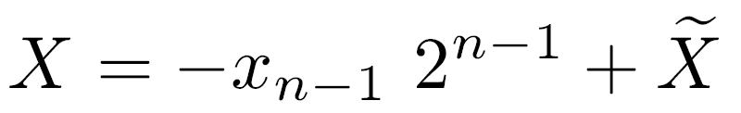
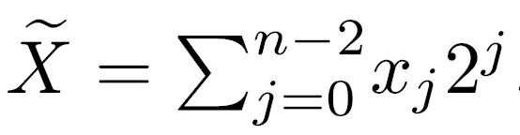
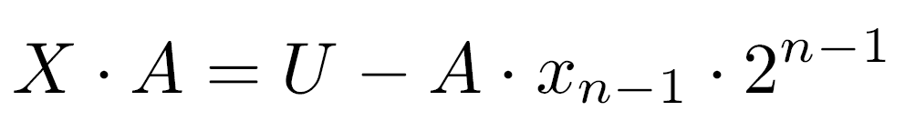
Negative Multiplier - Two’s Complement
Each bit considered separately - sign bit (with negative weight) treated differently than other bits
Two's complement numbers - ;
If sign bit of multiplier is ignored -
X⋅A is the desired product - if xn-1=1 - a correction is necessary
The multiplicand A is subtracted from the most significant half of U

Slide 9
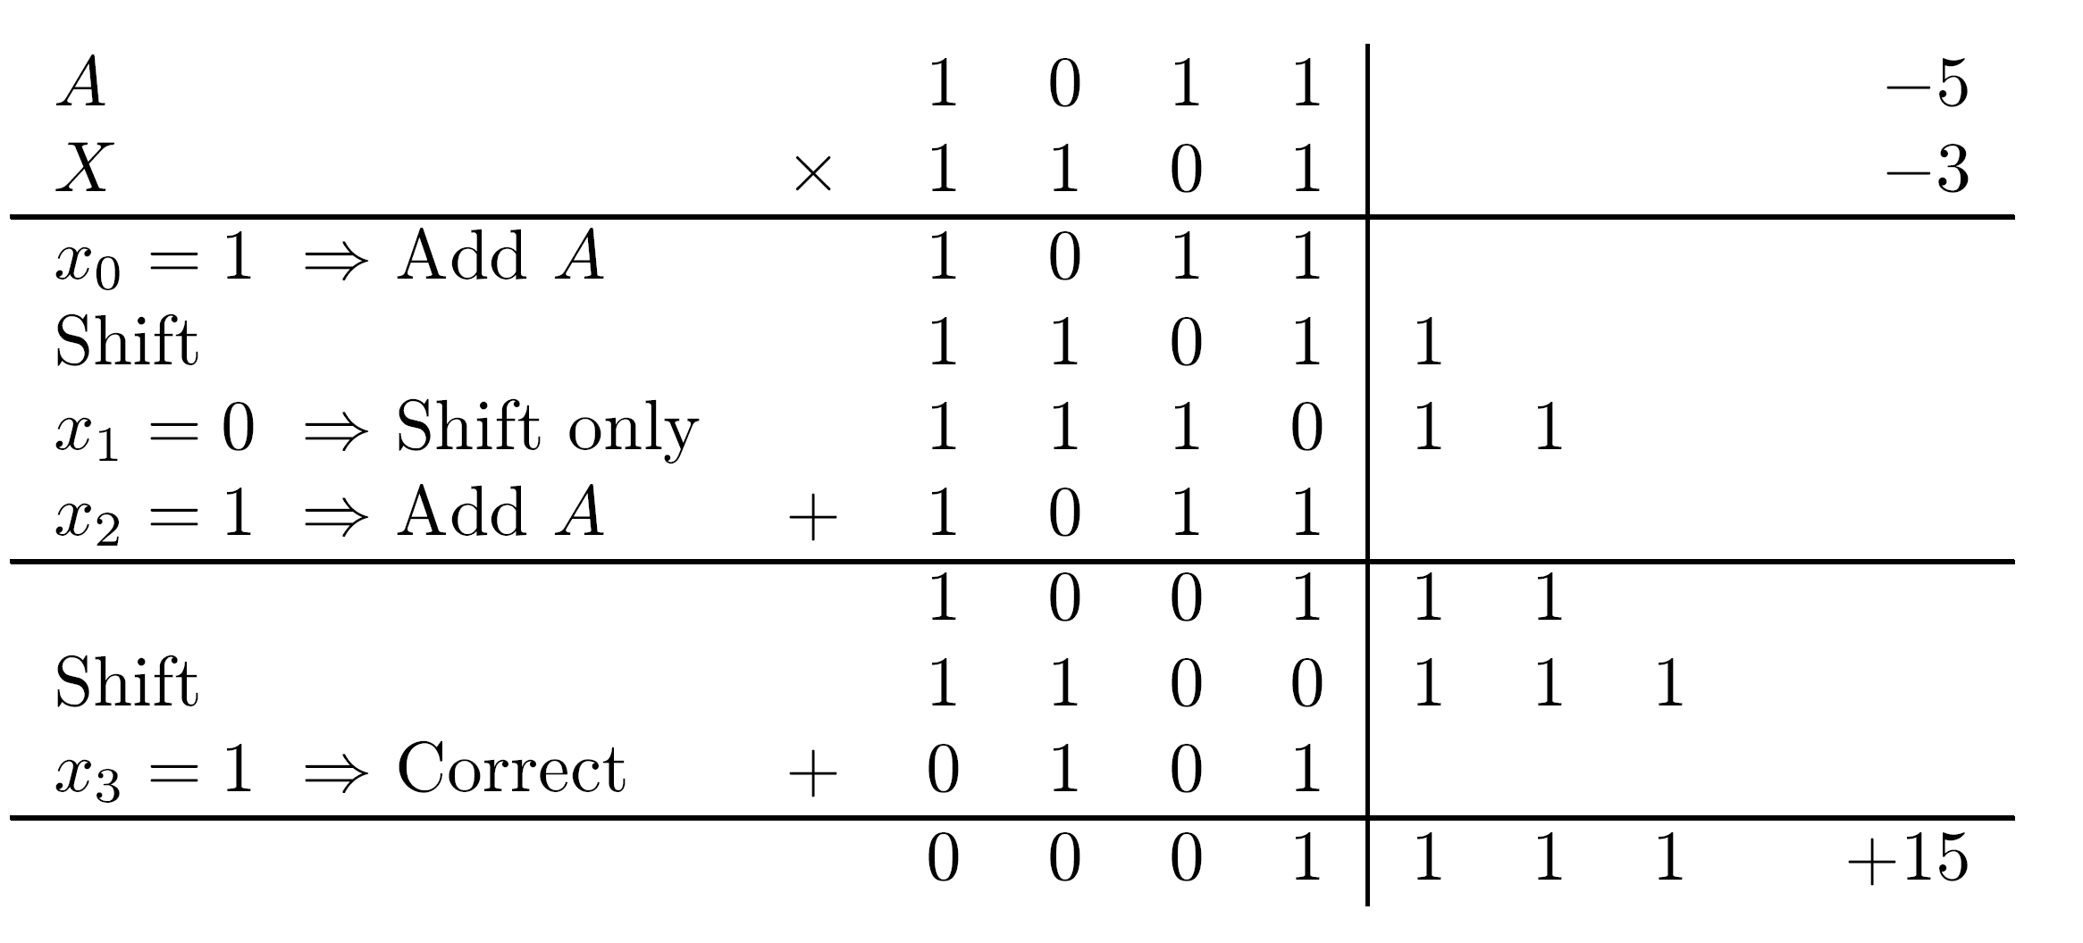
Negative Multiplier - Example
Multiplier and multiplicand - negative numbers in two's complement
In correction step, subtraction of multiplicand is performed by adding its two's complement

Slide 10
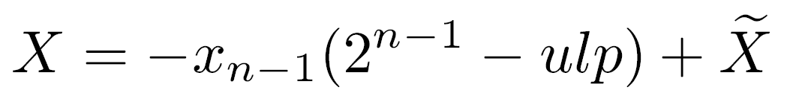
Negative Multiplier - One’s Complement
and
If xn-1=1, start with P =A - this takes care of the second correction term xn-1 ⋅ ulp ⋅ A
At the end of the process - subtract the first correction term xn-1 ⋅ 2 ⋅ A
(0)
n-1

Slide 11
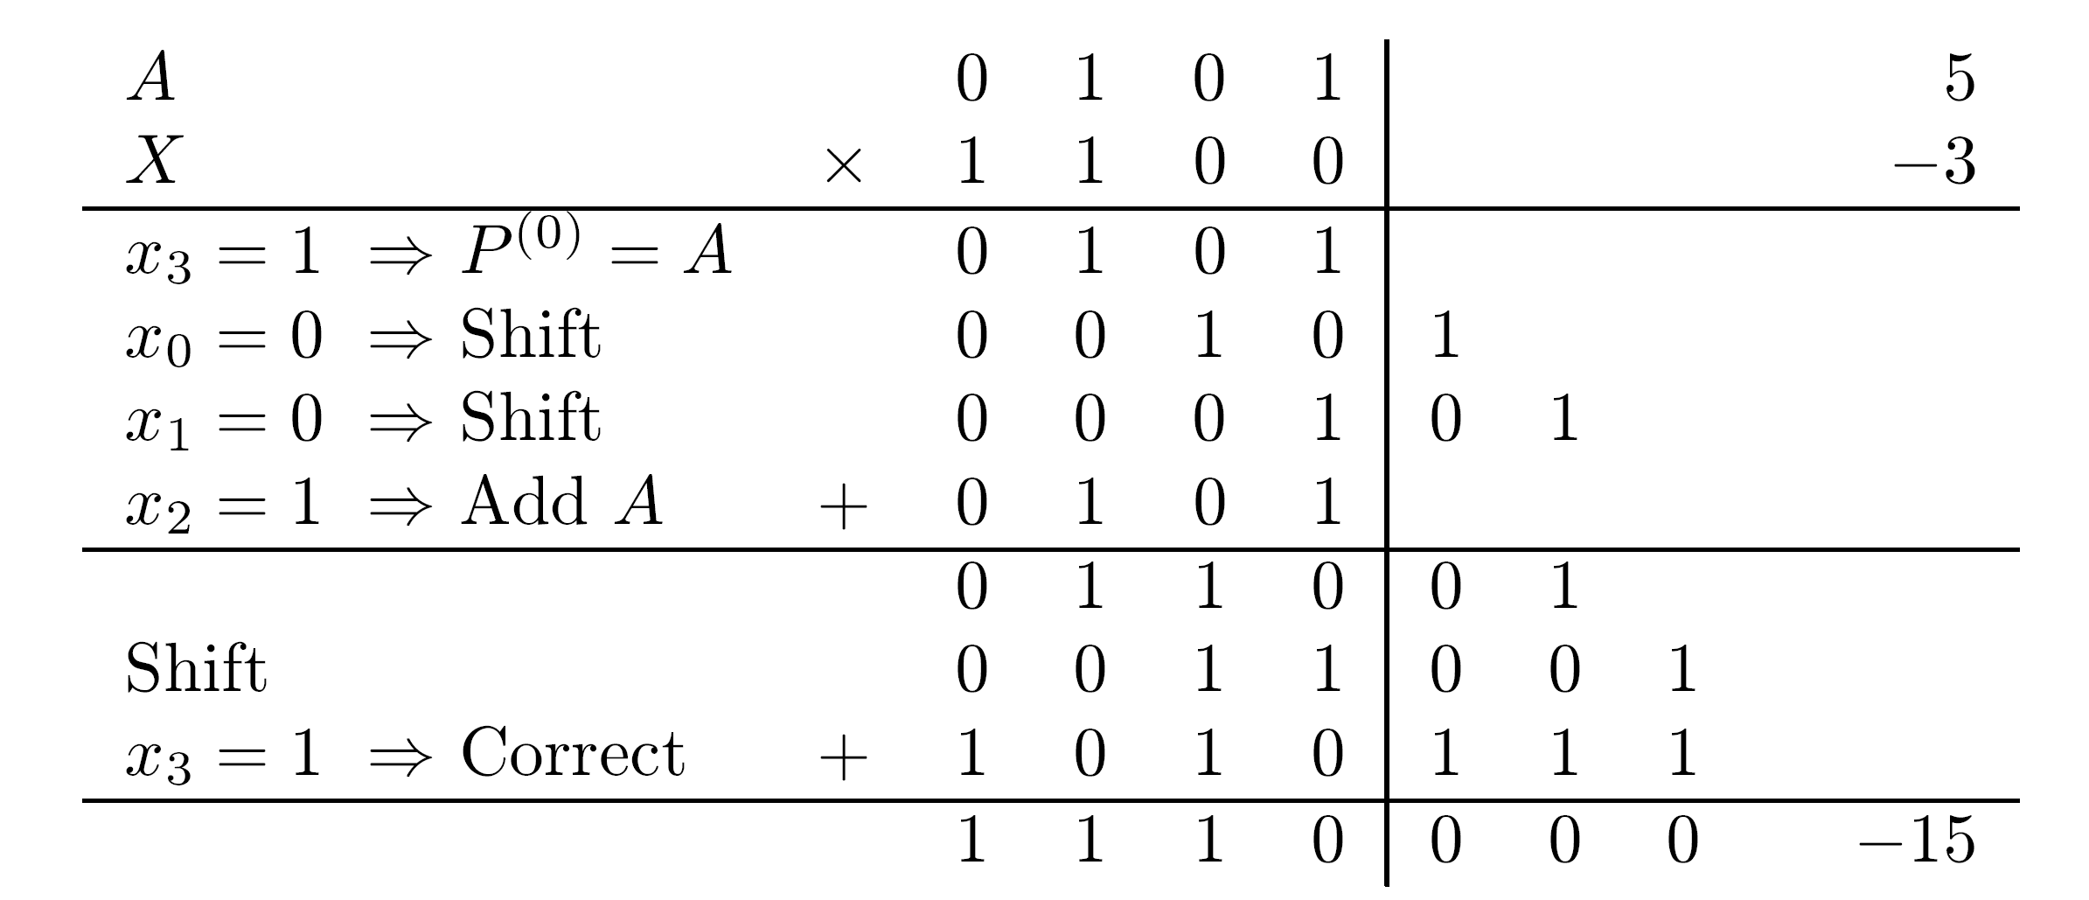
Negative Multiplier - Example
Product of 5 and -3 - one's complement
As in previous example - subtraction of first correction term - adding its one's complement
Unlike previous example - one's complement has to be expanded to double size using the sign digit - a double-length binary adder is needed

Slide 12
Sequential Division
Division - the most complex and time-consuming of the four basic arithmetic operations
In general, result of division has two components
Given a dividend X and a divisor D, generate a quotient Q and a remainder R such that
X = Q ⋅ D + R (with R < D)
Assumption - X,D,Q,R - positive
If a double-length product is available after a multiply and we wish to allow the use of this result in a subsequent divide, then
X may occupy a double-length register, while all other operands stored in single-length registers

Slide 13
Overflow & Divide by zero
Q ≤ largest number stored in a single-length register (<2 for a register with n bits)
1. X < 2 D - otherwise an overflow indication must be produced by arithmetic unit
Condition can be satisfied by preshifting either X or D (or both)
Preshifting is simple when operands are floating-point numbers
2. D ≠ 0 - otherwise - a divide by zero indication must be generated
No corrective action can be taken when D=0
n-1
n-1

Slide 14
Division Algorithm - Fractions
Assumption - dividend, divisor, quotient, remainder are fractions - divide overflow condition is X<D
Obtain Q=0.q1 ⋅ ⋅ ⋅ qm (m=n-1) - sequence of subtractions and shifts
Step i - remainder is compared to divisor D - if remainder larger - quotient bit qi=1, otherwise 0
ith step - ri = 2ri-1-qiD ; i=1,2,...,m
ri is the new remainder and ri-1 is the previous remainder (r0=X)
qi determined by comparing 2ri-1 to D - the most complicated operation in division process

Slide 15
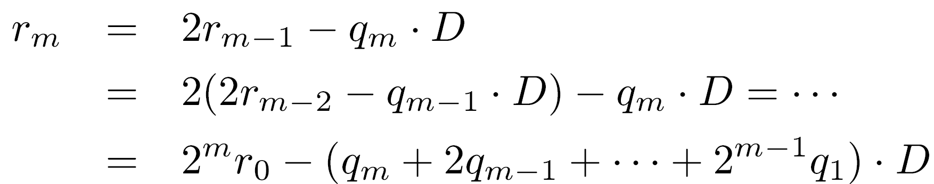
Division Algorithm - Proof
The remainder in the last step is rm and repeated substitution of the basic expression yields
Substituting r0=X and dividing both sides by 2 results in
hence rm2 = X - Q ⋅ D as required
True final remainder is R=rm2
m
-m
-m

Slide 16
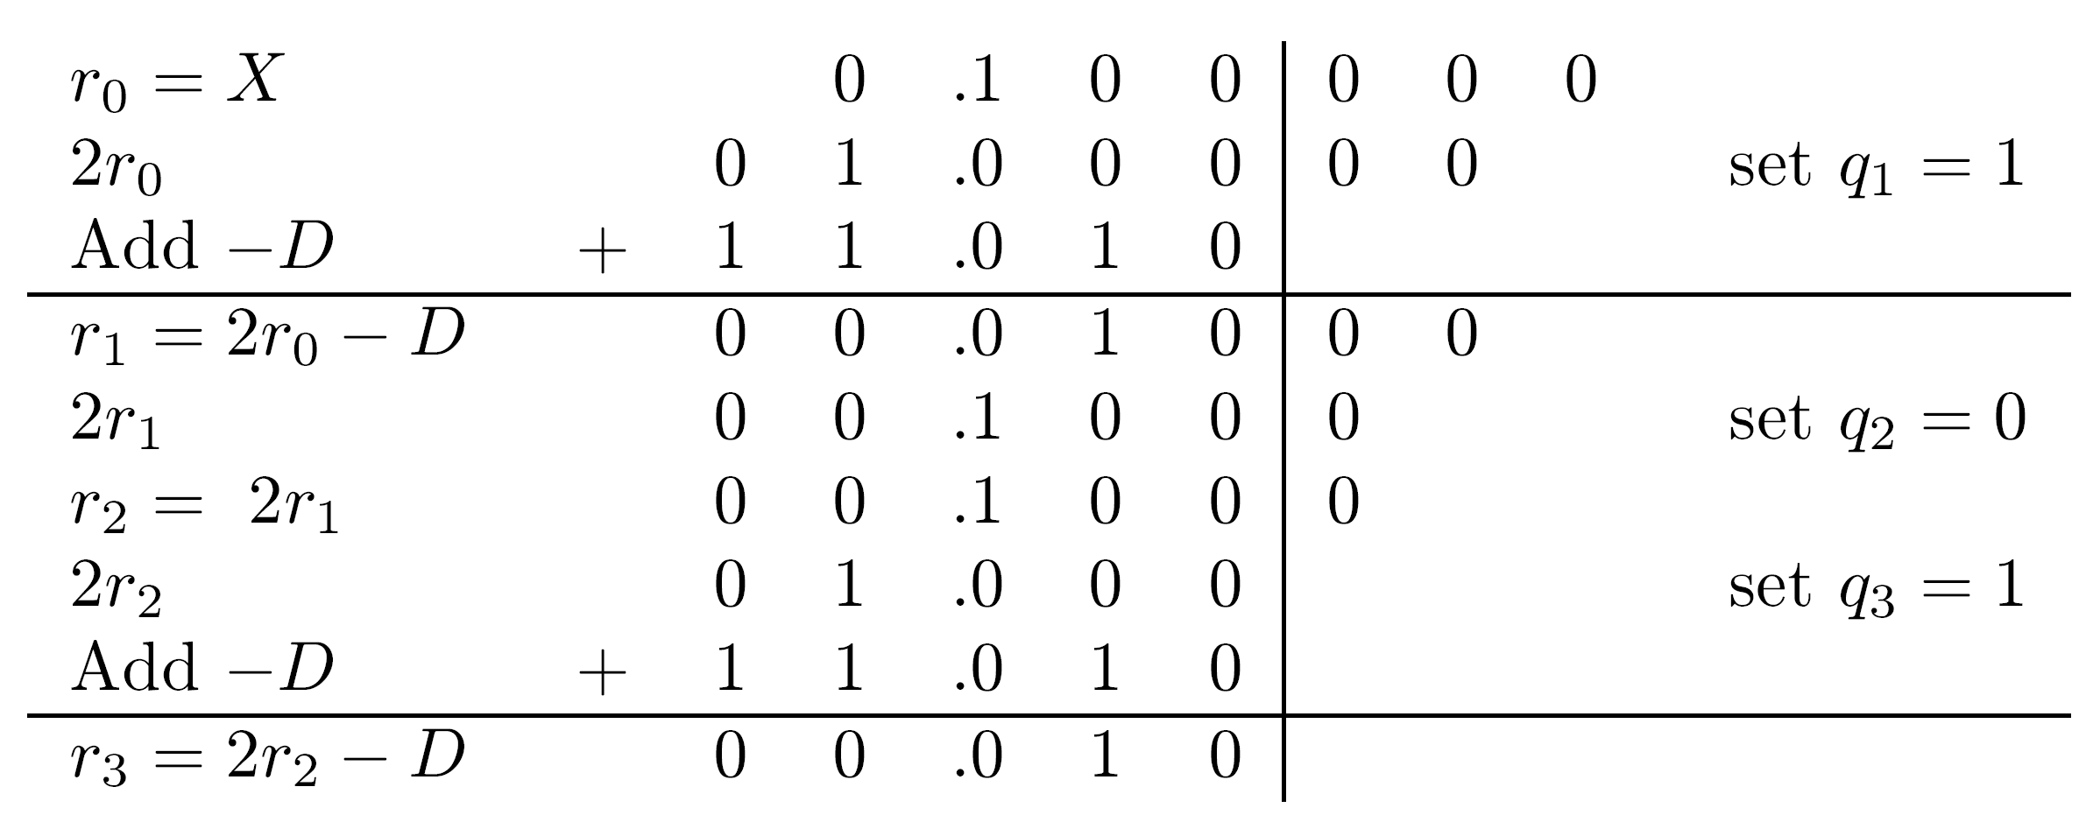
Division - Example 1 - Fractions
  X=(0.100000)2=1/2
  D=(0.110)2=3/4
  Dividend occupies double-length reg.
  X<D satisfied
Generation of 2r0 - no overflow
An extra bit position in the arithmetic unit needed
Final result : Q=(0.101)2=5/8
R=rm 2 =r32 =1/4 ⋅ 2 =1/32
Quotient and final remainder satisfy X=Q ⋅ D + R = 5/8 ⋅ 3/4 + 1/32 = 16/32 = 1/2
Precise quotient is the infinite binary fraction 2/3=0.1010101 ⋅ ⋅ ⋅
-m
-3
-3

Slide 17
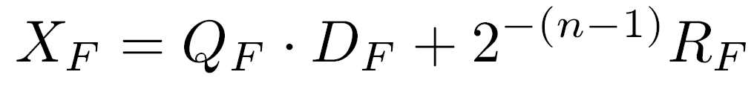
Division Algorithm - Integers
Same procedure; Previous equation rewritten - (XF,DF,QF,RF -fractions)
Dividing by 2 yields
The condition X < 2 D becomes XF < DF
X=01000002=32; D=01102=6
Overflow condition X<2 D is tested by comparing the most significant half of X, 0100, to D, 0110
The results of the division are Q=01012 =5 and R=00102=2
In final step the true remainder R is generated - no need to further multiply it by 2
2n-2
n-1
n-1
-(n-1)

Slide 18
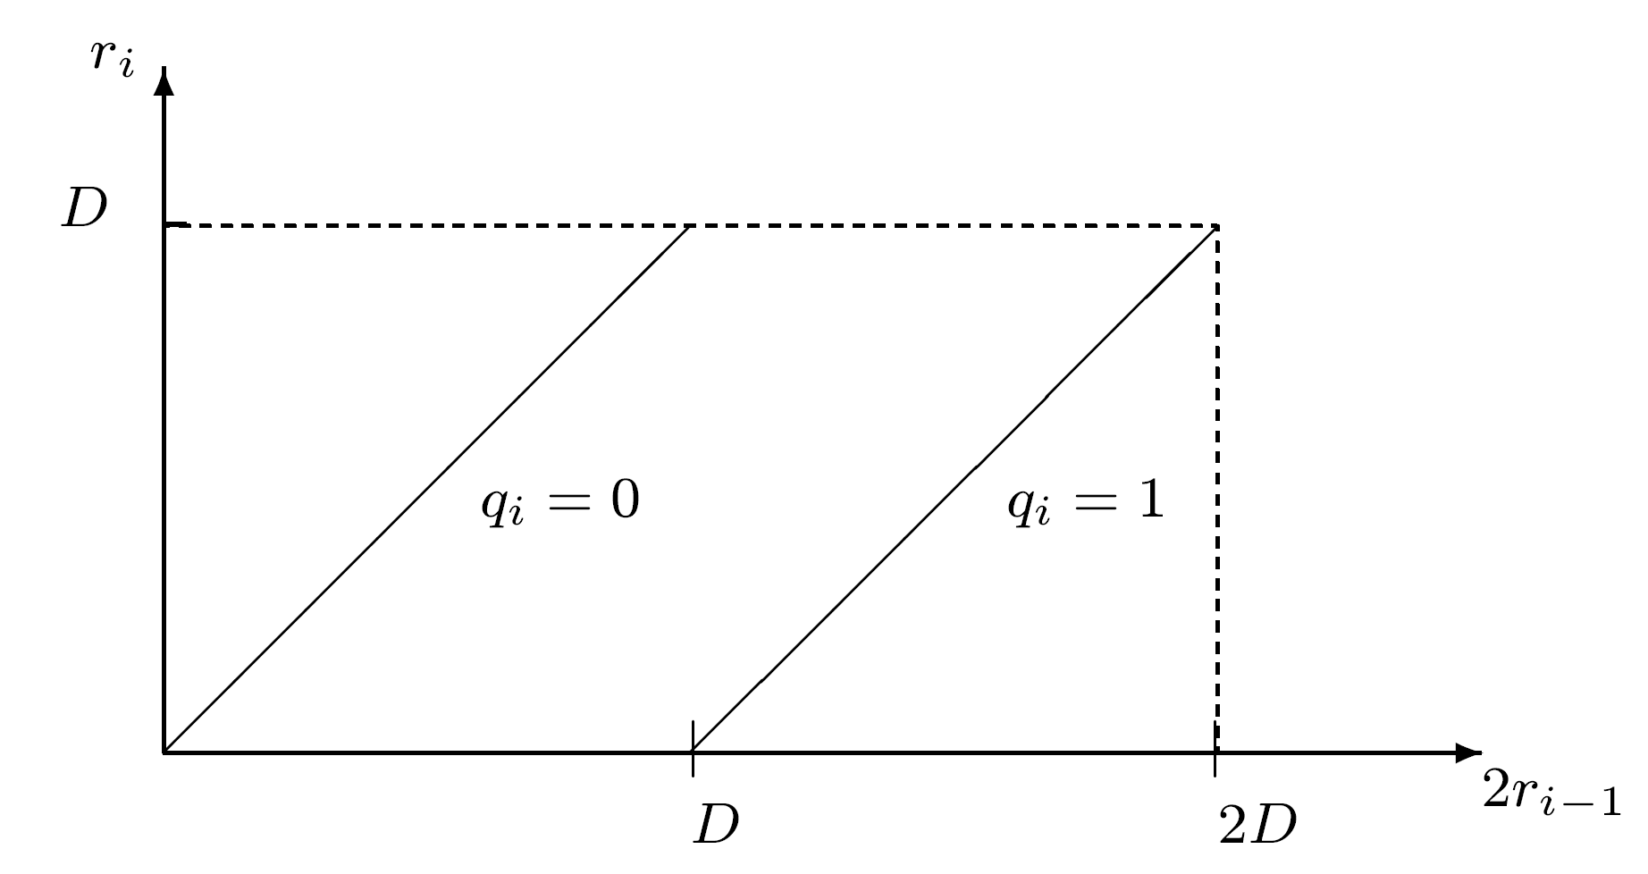
Restoring Division
Comparison - most difficult step in division
If 2ri-1-D<0 - qi=0 - remainder restored to its previous value - restoring division
Robertson diagram - shows that if ri-1<D, qi is selected so that ri<D
Since r0=X<D - R<D
m subtractions, m shift operations, an average of m/2 restore operations
  can be done by retaining a copy of the previous remainder - avoiding the time penalty

Slide 19
Nonrestoring Division - Remainder
Alternative - quotient bit correction and remainder restoration postponed to later steps
Restoring method - if 2ri-1-D<0 - remainder is restored to 2ri-1
Then shifted and D again subtracted, obtaining 4ri-1-D - process repeated as long as remainder negative
Nonrestoring - restore operation avoided
Negative remainder 2ri-1-D<0 shifted, then corrected by adding D, obtaining 2(2ri-1-D)+D=4ri-1-D
Same remainder obtained with restoring division

Slide 20
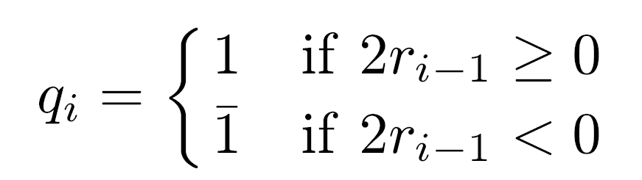
Nonrestoring Division - Quotient
Correcting a wrong selection of quotient bit in step i - next bit, qi+1, can be negative - 1
If qi was incorrectly set to 1 - negative remainder - select qi+1=1 and add D to remainder
Instead of qi qi+1=10 (too large) - qi qi+1=11=01
Further correction - if needed - in next steps
Rule for qi :
_
_
_

Slide 21
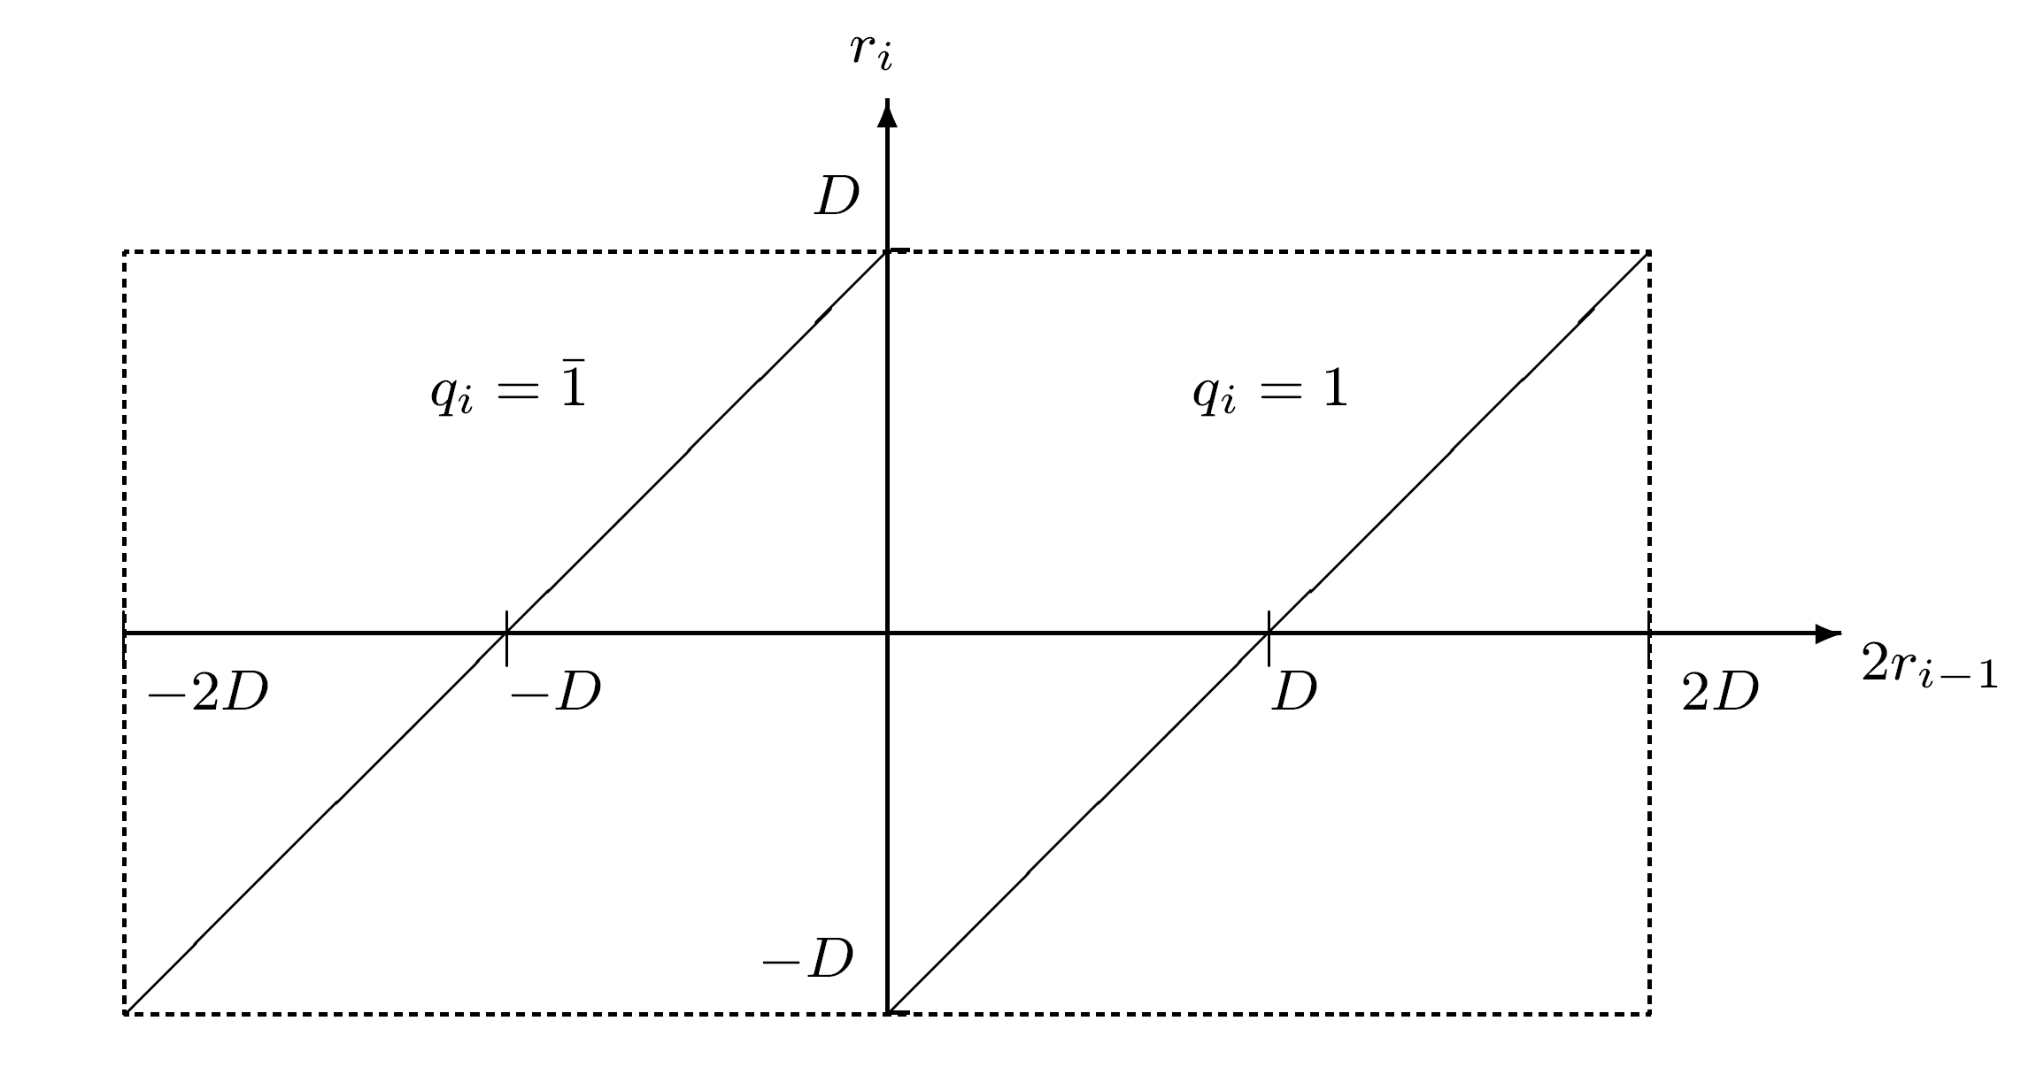
Nonrestoring Division - Diagram
Simpler and faster than selection rule for restoring division - 2ri-1 compared to 0 instead of to D
Same equation for remainder - qi = 2ri-1-qiD
Divisor D subtracted if 2ri-1 >0 , added if <0
  |ri-1|<D
  qi selected so |ri|<D
  qi≠0 - at each step, either addition or subtraction is performed
Not SD representation no redundancy in representation of quotient
Exactly m add/subtract and shift operations

Slide 22
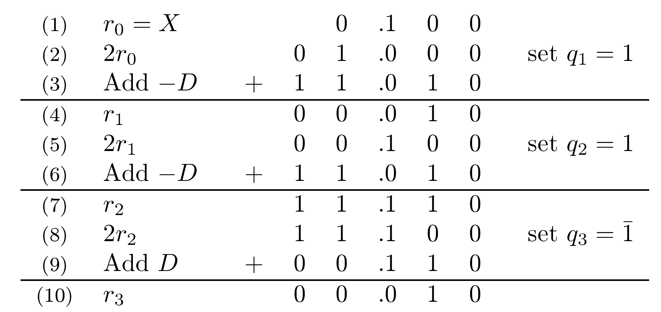
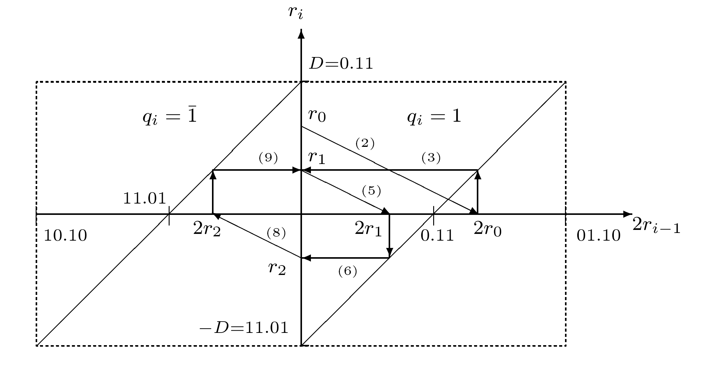
Nonrestoring Division - Example 1
X=(0.100000)2=1/2
D=(0.110)2=3/4
Final remainder - as before
Q=0.111=0.1012=5/8
Graphical representation
  Horizontal lines - add ±D
  Diagonal lines - multiply by 2
-

Slide 23
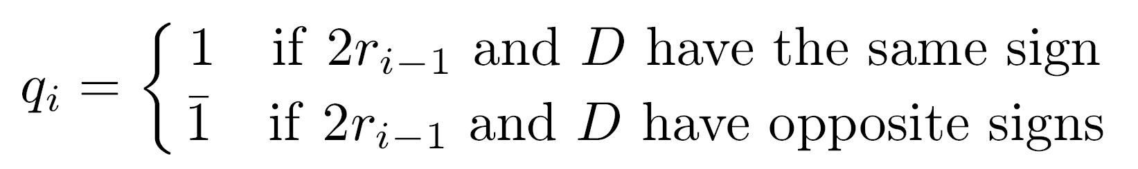
Nonrestoring Division - Advantage
Important feature of nonrestoring division - easily extended to two's complement negative numbers
Generalized selection rule for qi -
Remainder changes signs during process - nothing special about a negative dividend X

Slide 24
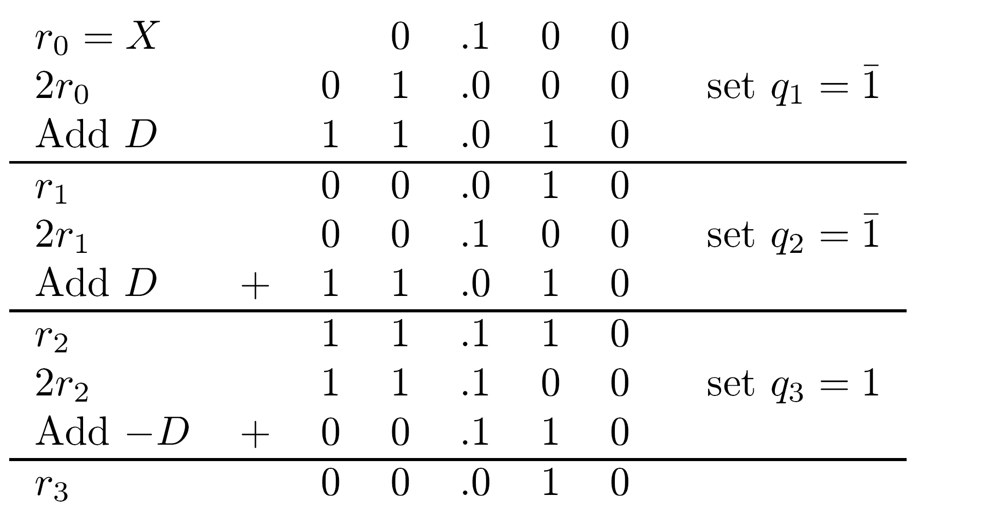
Nonrestoring Division - Example 2
X=(0.100)2=1/2
D=(1.010)2=-3/4
Final quotient - Q=0.111=0.1012=-0.1012=-5/8 =1.011 in two’s complement
Final remainder = 1/32 - same sign as the dividend X
-
-
-
-

Slide 25
Nonrestoring Division - sign of remainder
Sign of final remainder - same as dividend
Example - dividing 5 by 3 - Q=1, R=2, not Q=2, R=-1 (although |R|<D)
If sign of final remainder different from that of dividend - correction needed - results from quotient digits being restricted to 1,1
Last digit can not be 0 - an “even" quotient can not be generated
-

Slide 26
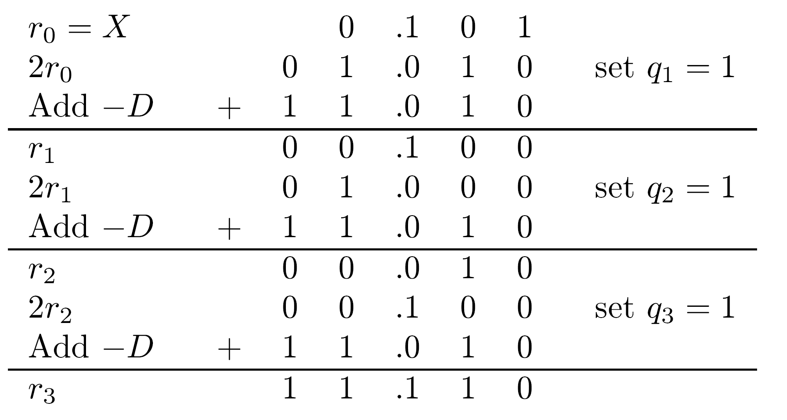
Nonrestoring Division - Example 3
X=0.1102= 5/8
D=0.1102= 3/4
Final remainder negative - dividend positive
Correct final remainder by adding D to r3 - 1.110+0.110=0.100
Correct quotient - Qcorrected = Q - ulp
Q=0.111 - Qcorrected=0.1102=3/4

Slide 27
Nonrestoring Division - Cont.
If final remainder and dividend have opposite signs - correction needed
If dividend and divisor have same sign - remainder rm corrected by adding D and quotient corrected by subtracting ulp
If dividend and divisor have opposite signs - subtract D from rm and correct quotient by adding ulp
Another consequence of the fact that 0 is not an allowed digit in non-restoring division - need for correction if a 0 remainder is generated in an intermediate step

Slide 28
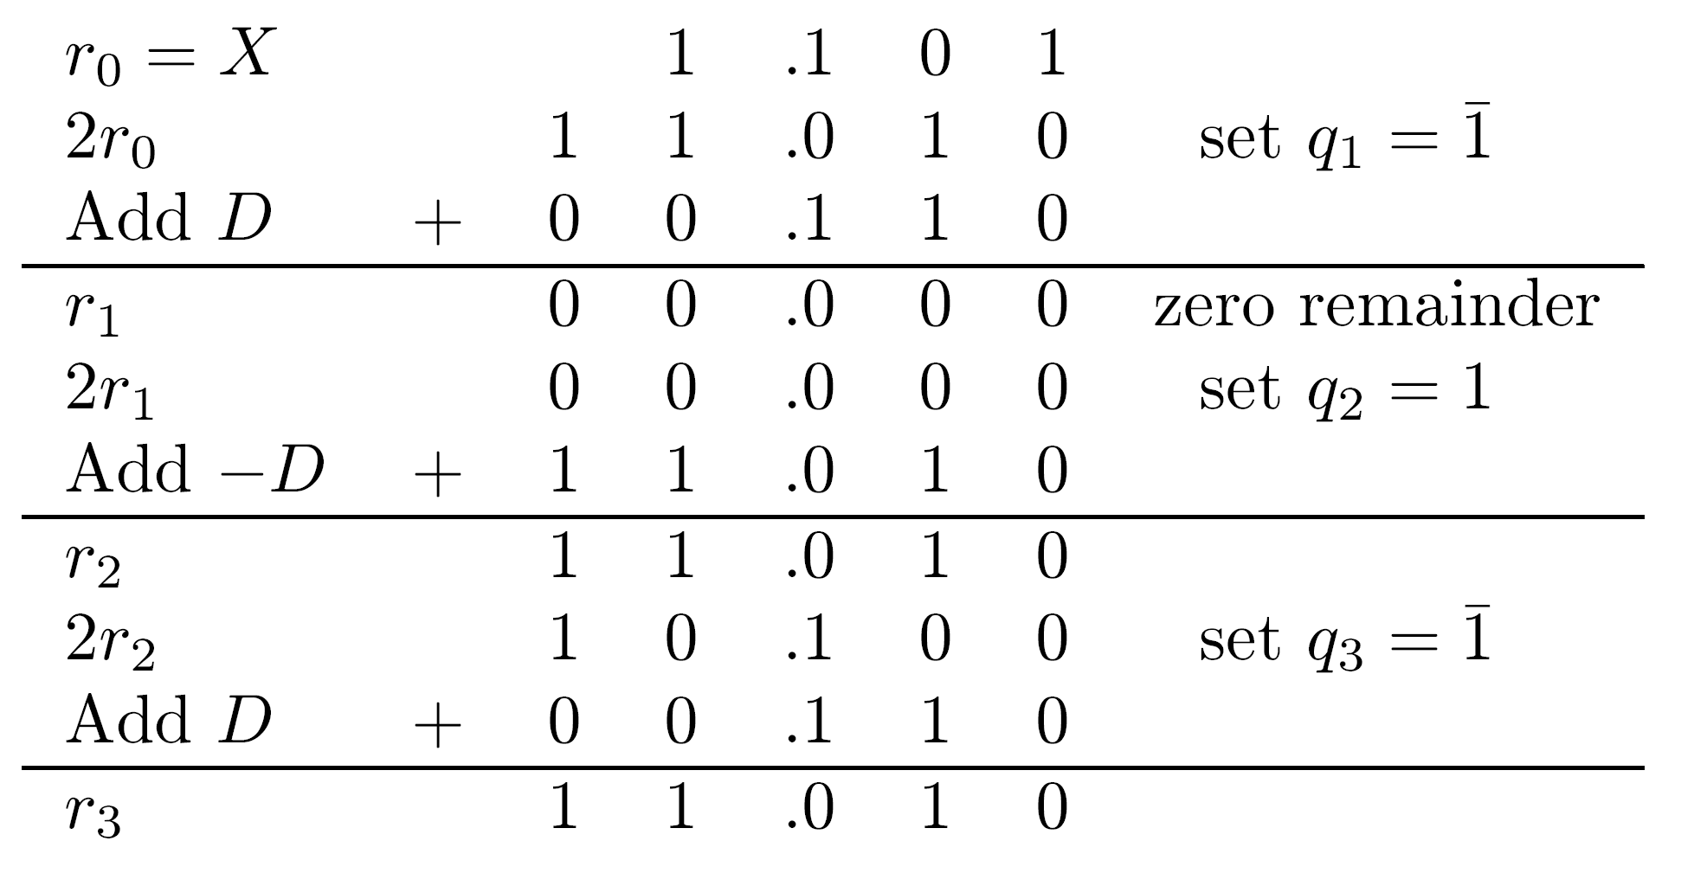
Nonrestoring Division - Example 4
X=1.1012=-3/8
D=0.1102=3/4
Correct result of division - Q=-1/2; R=0
Although final remainder and dividend have same sign - correction needed due to a zero intermediate remainder
This must be detected and corrected -
r3(corrected) = r3+D=1.010+0.110=0.000
Correcting the quotient Q=0.111=0.101 by subtracting ulp : Q(corrected) = 0.1002=-1/2
-
-
-
-

Slide 29
Generating a Two's Complement Quotient in Nonrestoring Division
-
Converting from using 1,1 to two's complement
Previous algorithms require all digits of quotient before conversion starts - increasing execution time
Preferable - conversion on the fly - serially from most to least significant digit as they become available
Quotient digit assumes two values - single bit sufficient for representation - 0 and 1 assigned to 1 and 1
Resulting binary number - 0.p1...pm ( pi=1/2(qi+1) )
-

Slide 30
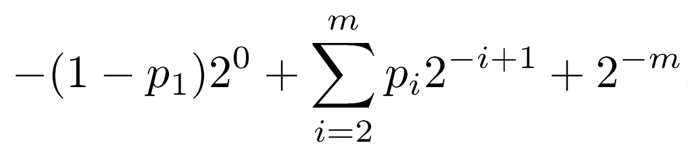
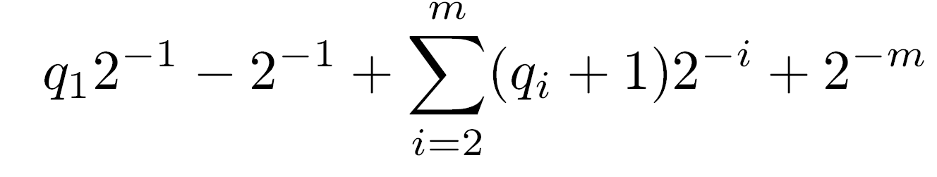
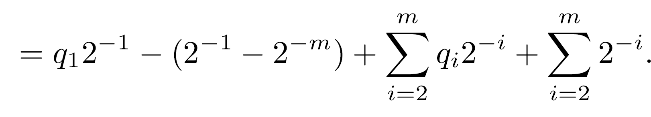
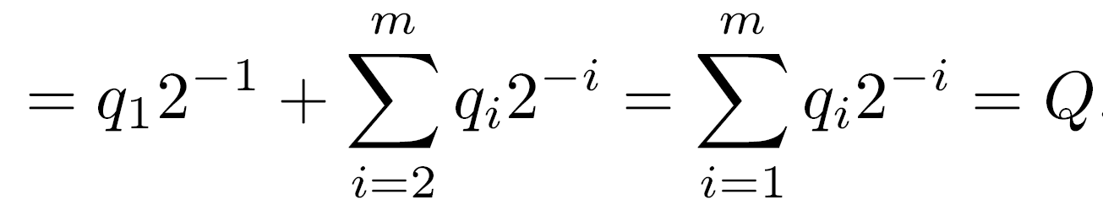
Conversion Algorithm
Step 1: Shift number one bit position to left
Step 2: Complement most significant bit
Step 3: Shift a 1 into least significant position
Result - (1-p1).p2p3...pm1 - has same numerical value as original quotient Q
Proof: Value of above sequence in two's complement -
Substituting pi=1/2(qi+1) -
Last term = 2 -2
-1
-m

Slide 31
Conversion Algorithm - Example
Algorithm can be executed in a bit-serial fashion
Example - X=1.101 ; D=0.110
Instead of generating the quotient bits .111 - generate the bits (1-0).101=1.101
After correction step - Q-ulp=1.100 - correct representation of -1/2 in two's complement
Exercise - The same on-the-fly conversion algorithm can be derived from the general SD to two's complement conversion algorithm presented before
-
-
-
-

Slide 32
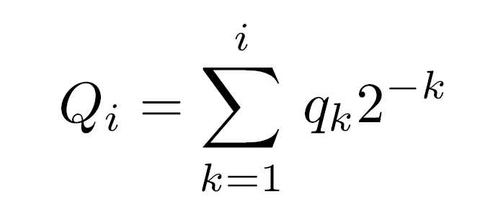
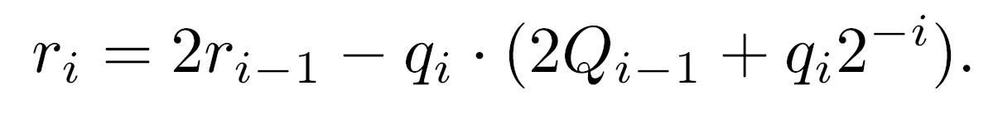
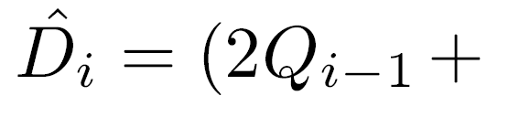
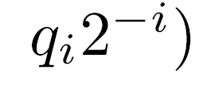
Square Root Extraction - Restoring
The conventional completing the square method for square root extraction is conceptually similar to restoring division
X - the radicant - a positive fraction ; Q=(0.q1 q2...qm) - its square root
The bits of Q generated in m steps - one per step
- partially developed root at step i (Qm=Q) ; ri - remainder in step i
Calculation of next remainder -
Square root extraction can be viewed as division with a changing divisor -

Slide 33
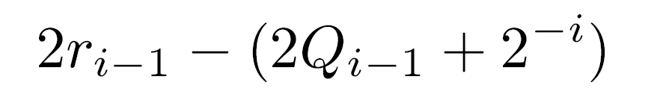
Square Root Extraction - Cont.
First step - remainder=radicand X ; Q0=0
Performed calculation -
To determine qi in the restoring scheme - calculate a tentative remainder
q1.q2 … qi-101 = 2Qi-1+2 - simple to calculate
If tentative remainder positive - its value is stored in ri and qi=1
Otherwise - ri=2ri-1 and qi=0
-i

Slide 34
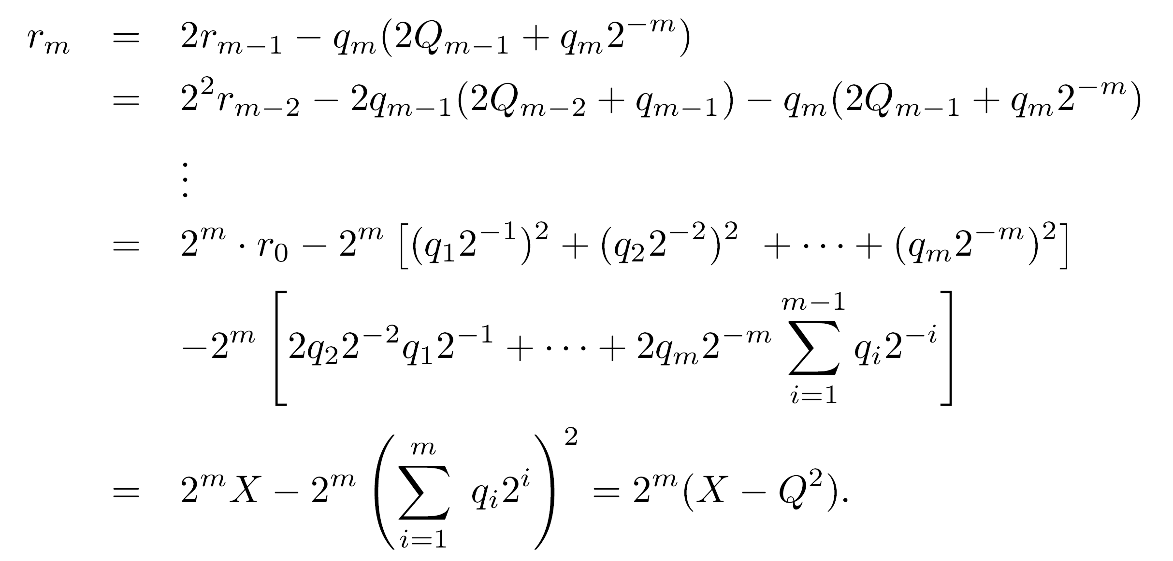
Proof of Algorithm
Repeated substitution in the expression for rm -
Dividing by 2 results in the expected relation with rm2 as the final remainder
m
-m

Slide 35
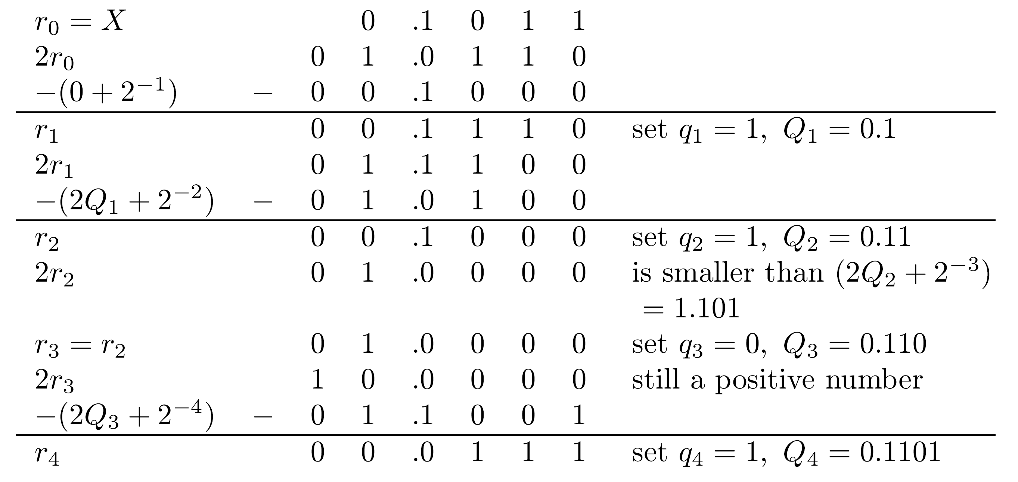
Example - Square root (Restoring)
X=0.10112=11/16=176/256
Q=0.11012=13/16
Final remainder=2 r4=7/256=X-Q =(176-169)/256
-4
2

Slide 36
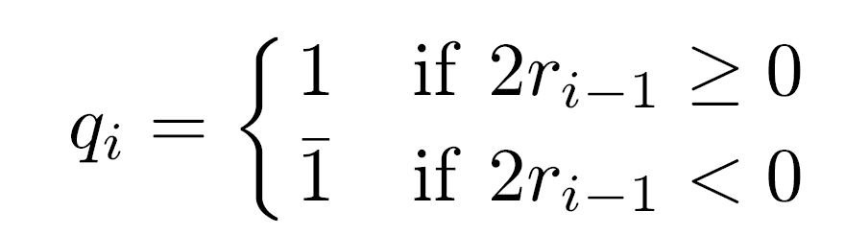
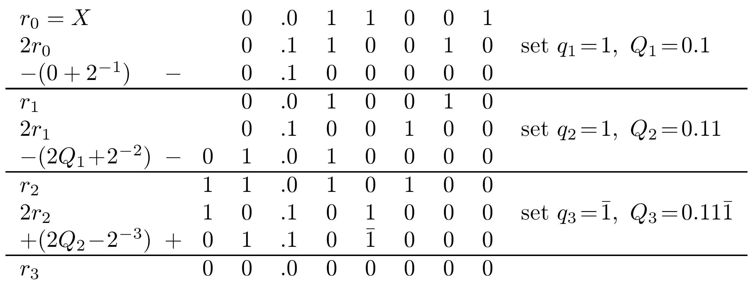
Different Algorithm - Nonrestoring
Second algorithm - similar to nonrestoring division
Example -
  X=0.0110012 =25/64
Square root -
  Q=0.111 =0.1012=5/8
Converting the digits of Q to two's complement representation - similarly to nonrestoring division
Faster algorithms for square root extraction exist
-

